Slide 1
Chest Radiology Basics

Slide 2
Expectations; Knowledge
Learn normal mediastinal and hilar anatomy
Learn patterns of atelectasis;
Learn lung parenchymal texture, and patterns of abnormality;
Recognize emphysema and tracheobronchial disease and inflammatory airway diseases;
Understand pulmonary arterial and venous hypertension as well as pulmonary perfusion patterns;
Identify cardiac chamber enlargement;
Detect parenchymal nodules and masses;
Identify inhalation lung disease;
Recognize primary malignant and metastatic disease;
Distinguish infectious disease in normal and immune-compromised hosts;
Recognize hypersensitivity, idiopathic interstitial lung reactions and diffuse infiltrative lung disease;
Understand anatomy and pathology of lung transplantation;
Recognize common lesions in the regional skeleton of the chest.

Slide 3
Expectations; Technical Skills
Make use of the PACS system.
Dictate concise but informative reports.
Use our dictation system to review and edit reports.
Look up old films and reports on current patients.
Organize the flow of work.
Present a conference case.
Become competent at using the paging system.
Provide consultation to house staff and attendings.
Maintain quality control of chest films.
Acquire detailed knowledge about PACS.

Slide 4
Expectations; decision making
Decide when to contact a referring physician or house staff member.
Decide when to make an effort to find old films.
Know when to refer a physician to an attending.
Know how to balance conflicting interpretations of films.

Slide 5
Expectations; 2nd rotation
Fill in the gaps in their knowledge about specific entities;
Read about diseases they are not likely to see during their rotation;
Integrate knowledge of x-ray manifestations with physiology, pathology.
Achieve greater independence in consultation/interpretation.
Decision making skills:
Understand when to get help.
Know what to put in a report and what to leave out.

Slide 6
Protocoling Studies
For Hillcrest, you’ll be using protocol viewer. Always have it up on your desktop and refresh it periodically to keep up to speed on them.
For VA, the techs will come to you with protocols. If they’re stat, walk them over to the front desk. If they’re outpatient, you can just put them in the “to-front-desk” slot.

Slide 7
Protocoling studies
If you want to see the lymph nodes well, characterize/rule out a mass or abscess, or see the vessels (PE/venous clot/aneurysm/dissection) you will need contrast. If you need to add it to a study (happens semi-frequently), you’ll have to talk to the ordering physician and ask them if you can add contrast.
If you are looking for an interstitial/fibrotic disease or s/p lung tx, do chest non-con thin-slice or “HRCT”.

Slide 8
Protocol Basics
Some of the time, you can simply explain what your trying to show and there’s a protocol for it:
“diffuse lung disease protocol”
“airway protocol”
“coronary artery protocol”
“PE protocol”
“aorta protocol”
“transplant protocol” (includes an expiratory scan)

Slide 9
Reasons to not give iodinated contrast VA guidelines
History of prior iodinated contrast reaction or allergy.
Serum Cr > 2.0 in a hydrated patient, unless being dialyzed within 24 hours post IV contrast.
Serum Cr > 1.4 in patients with diabetes.
Cardiovascular instability, shock, or pulmonary hypertension.
Patients with eGFR < 40, particularly those with cardiac decompensation or diabetes.
Patients who have had an iodinated contrast injection within 72 hours, who have Cr above baseline, and who are undergoing a second injection.
Patients who have eaten within 4 hours prior to an iodinated contrast injection.

Slide 10
Reasons to not give Gad VA guidelines
Prior allergic reaction to gadolinium requiring pretreatment.
Prior allergic reaction to iodinated contrast, and no prior gadolinium injection so that cross sensitivity is unknown.
Patients with eGFR < 30.
Patients with Nephrogenic Systemic Fibrosis and Nephrogenic Fibrosing Dermopathy (NSF/ NFD).
Patients with ESRD.
Patients with acute kidney injury and/or significant liver disease.
Patients with kidney or liver transplant.

Slide 11
Anatomy
You’ll be starting out with chest radiographs, so learn the CXR anatomy really well.
Obviously look over the thoracic anatomy (Netters, Grants, radprimer, statdx)
CT thorax often extends from the lower neck to the upper poles of the kidneys

Slide 12
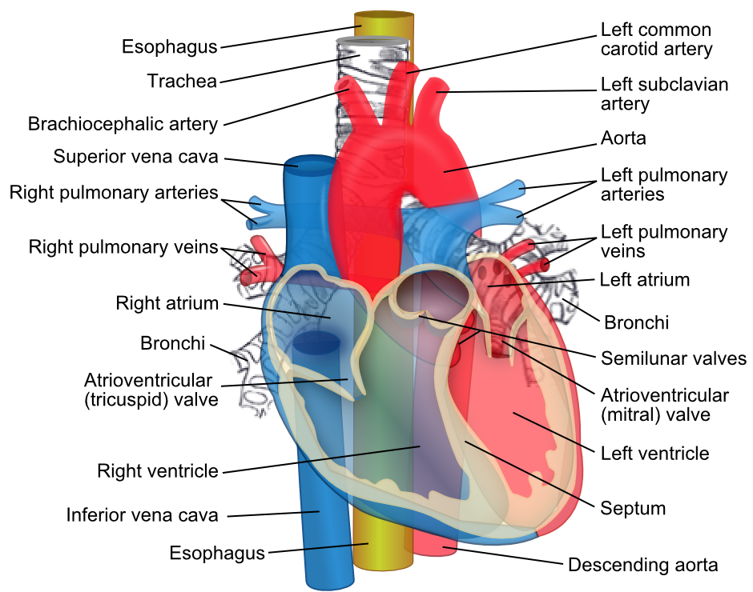
Mediastinal structures

Slide 13
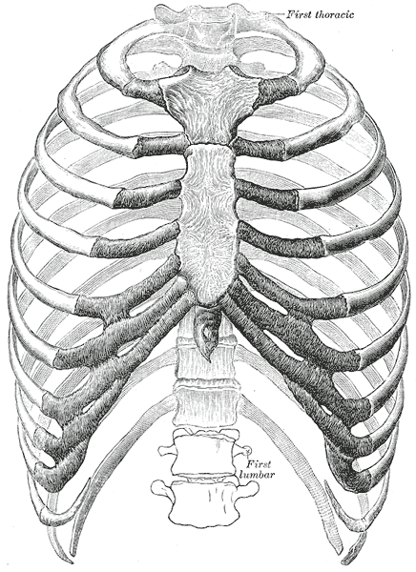
Ribs

Slide 14
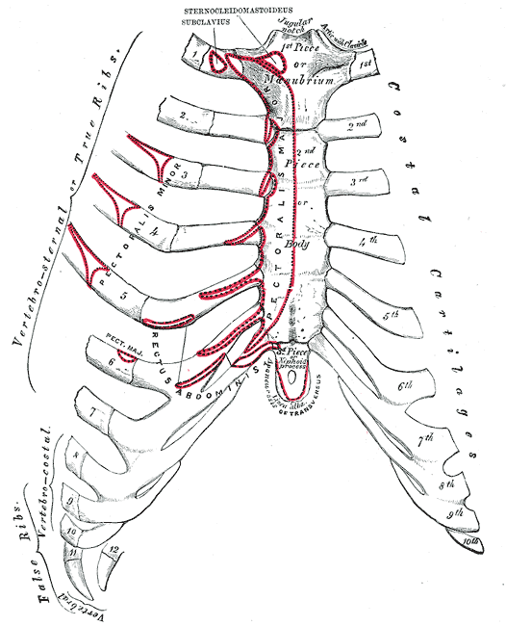
Sternum

Slide 15
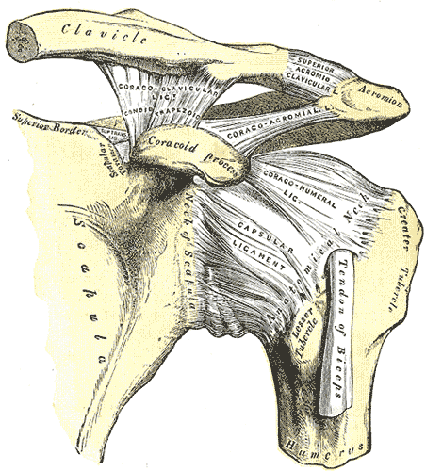
Shoulder

Slide 16
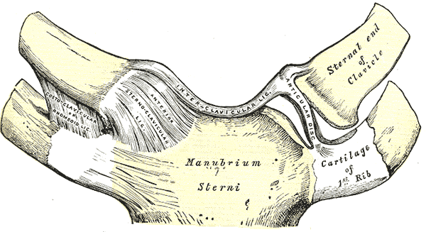
Costochondral Junction

Slide 17
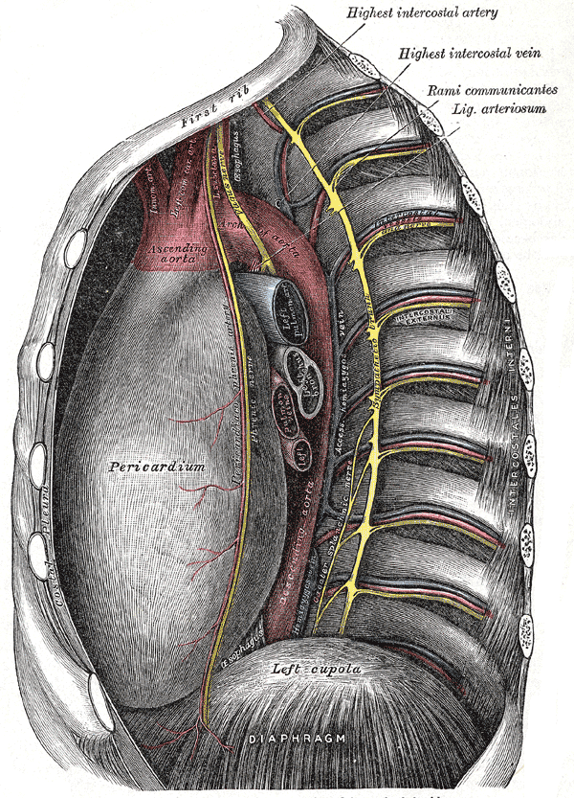
Thoracic Aorta

Slide 18
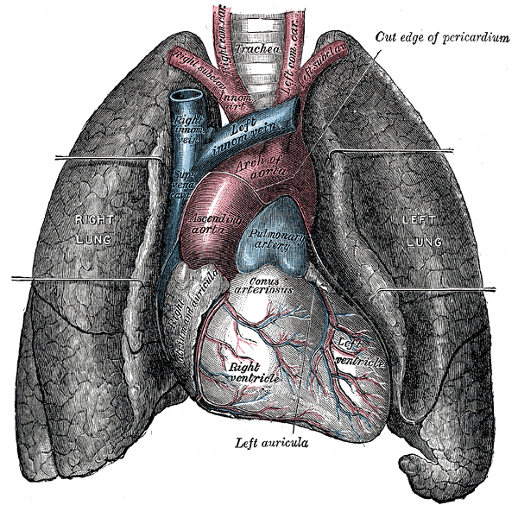
Heart

Slide 19
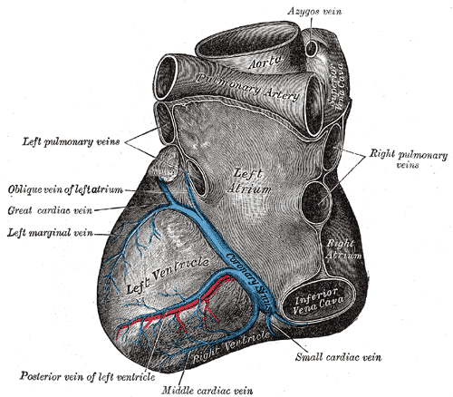
Posterior Heart

Slide 20
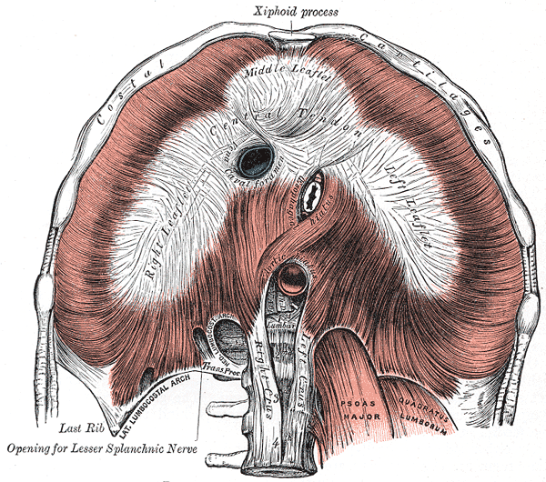
Diaphragm

Slide 21
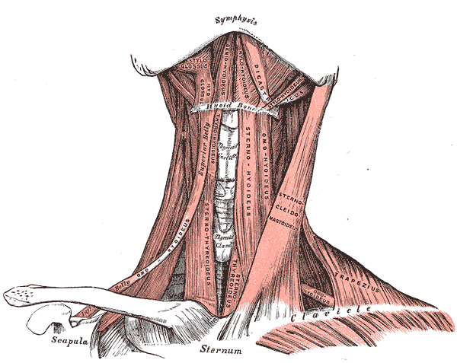
Neck

Slide 22
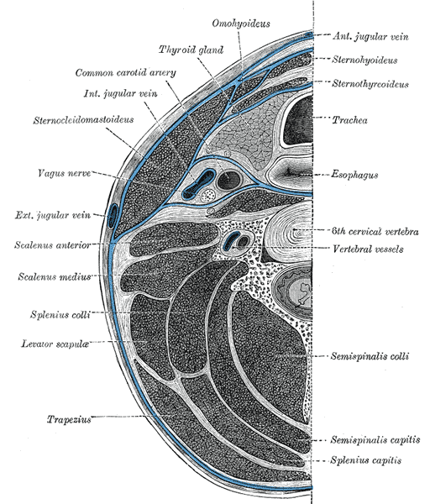
Axial cut of neck at C6

Slide 23
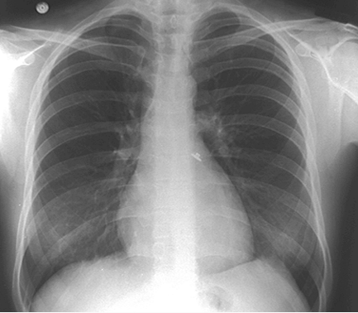
Anatomic landmarks
Trachea
Aortic Arch
Carina
L PA
R PA
Descending Aorta
RA
Paraspinal line
LV
Azygoesophageal line

Slide 24
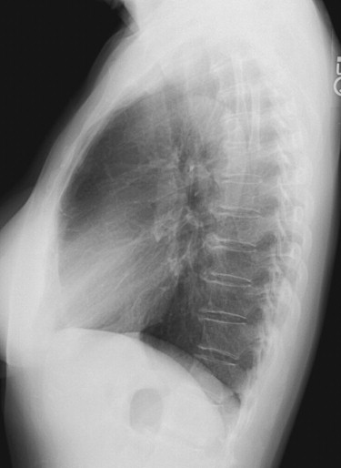
Anatomic landmarks
Trachea
Aortic Arch
Trachea
PA
Bronchus intermedius
Descending Aorta
LA
LV
IVC
R hemidiaphragm
L hemidiaphragm

Slide 25
Vascular Pedicle
Vascular Pedicle is bordered on the right by the SVC (at the crossing between the SVC and the main bronchus) and on the left by the left subclavian artery origin.
Normal is between 38 and 58 mm

Slide 26
Common Blindspots on CXR
1. Upper lobes (usually RUL); due to high frequency, overlapping shadows from clavicles, ribs, and vascular structures.
2. Mediastinum
3. Hila
4. retrocardiac space
5. extrapulmonary structures

Slide 27
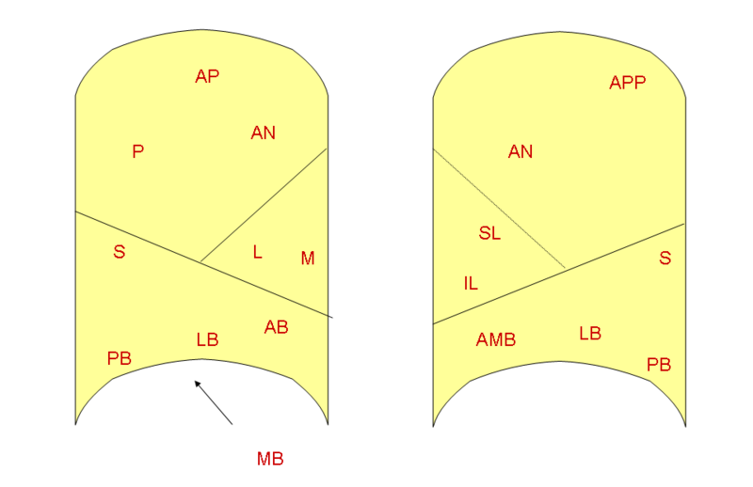
Lung Segments (lateral views)

Slide 28
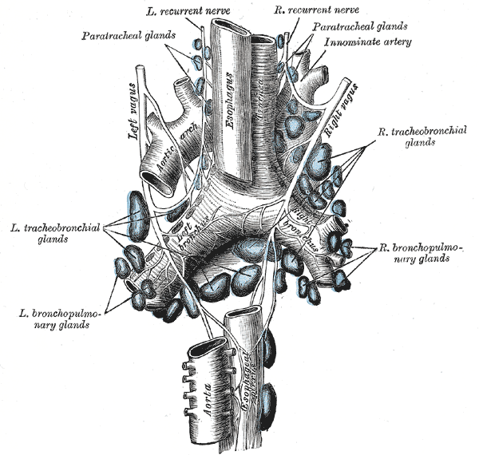
Mediastinal Lymph Nodes
Upper paratracheal
Lower paratracheal
Lobar
Interlobar
Subcarinal
Paraesophageal

Slide 29
Measurements
You won’t use these all the time, but it’s good to know what normal is. Here’s some commonly used values:
Trachea 25mm coronal, 27mm sagittal; considered saber sheath (COPD) when coronal:sagittal ratio is 1.6.
Azygos <10mm
Chest wall AP/T ratio nl <0.37
Main Pulmonary Artery 29mm
Aorta 40mm (at level of main pulm artery)
R atrium 32mm +/- 12mm (on CT, internal transverse diameter, level of mitral valve)
R atrium <5.5mm (on CXR, dist from midline to R hrt border)
L atrium 40mm +/- 9mm (on CT, AP intern diam at level of MV)
L ventricle thickenss (including septum) 12mm

Slide 30
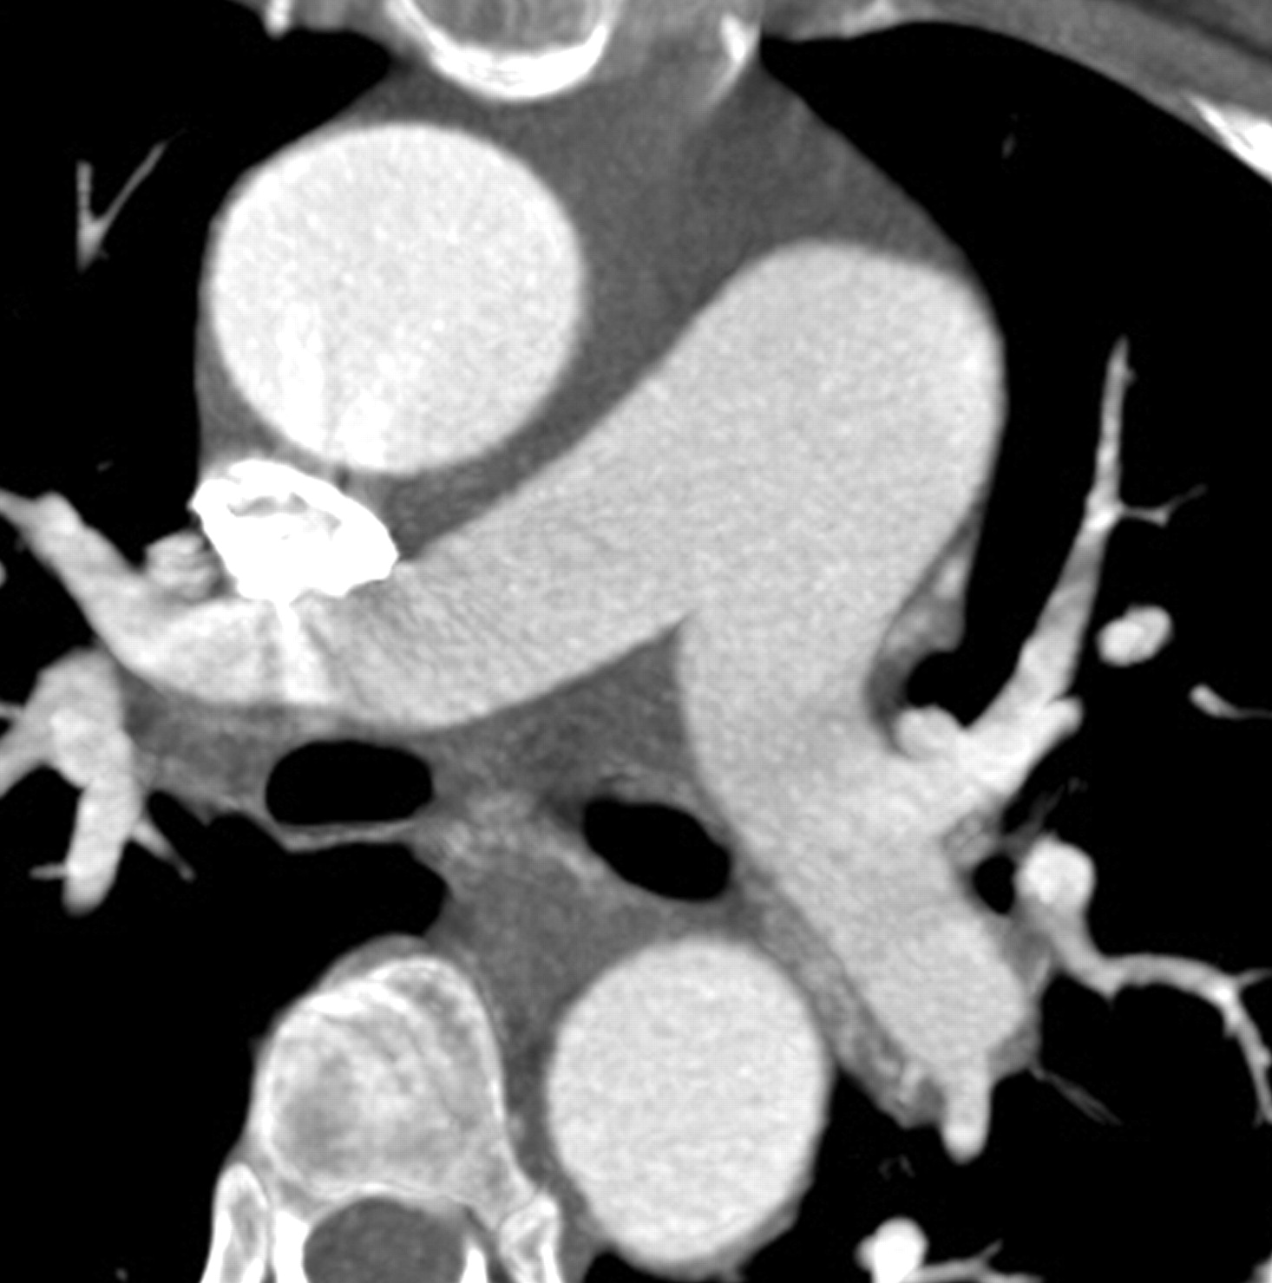
Anatomic Landmarks
This is where you measure the MPA and AA diameters on CT.

Slide 31
Thymus
It’s normally subtle, with concave borders. Sometimes it shows up after stress/ chemotherapy (thymic rebound).

Slide 32
Atelectasis
The most common abn found on CXR; B&H pg349.
Here are the subtypes and examples of each
Obstructive (resorptive) – found in mucus plug, bronchogenic carcinoma, or external compression of airway
Passive (relaxation) – Pleural effusion and PTX
Compressive – Anything that could compress it (bullae)
Cicatricial – Post-primary Tb and radiation fibrosis
Adhesive – Respiratory distress syndrome of the newborn

Slide 33
Discoid Atelectasis
Discoid “band-like opacity”
Often along fissure or in the bases of the lungs
Often causes shift of nearby structures

Slide 34
Nodules
You will get a lot of “follow-up Pulmonary Nodule” CTs, where you just look for and measure nodules, and compare them to the priors. If there are a lot of nodules, dictate that there are “multiple” or “numerous” nodules and measure just a few (usually the biggest).

Slide 35
Nodules
The Fleischner Criteria. It will be very helpful to know these.
Nodule Size (mm) | Low-Risk Patient | High-Risk Patient
< 4 | No follow up needed | Follow-up CT at 12 mo; if unchanged, no further follow up
> 4-6 | Follow-up CT at 12 mo; if unchanged, no further follow up | Initial follow-up CT at 6-12 mo then at 18-24 mo if no change
>8 | Follow-up CT at around 3, 9, and 24 mo, dynamic contrast-enhanced CT, PET, and/or biopsy | Same as for low-risk patient

Slide 36
Lung Cancer
 | Diameter | Medianoscopy | Atelectasis | Invasion | Nodules
T1 | T1a<2cm T1b>2-3cm | No invasion Lobar bronchus
T2 | T2a>3-5cm T2b>5-7cm | Main bronchus > 2cm to carina | Atelectasis or obstructive PNA to hilus not entire lung | Visceral pleura
T3 | >7cm | <2cm to carina | Whole lung | Diaphragm phrenic nerve Mediast pleura Parietal pericardium | Nodules in same lobe
T4 |  | Tumor in carina |  | Heart Great Vessels Trachea Esophagus spine | Nodules in other lobes

Slide 37
Lung Cancer
N1 – In ipsilateral peribronchial and/or ipsilateral hilar lymph nodes and intrapulmonary nodes
N2 – In ipsilateral mediastinal and/or subcarinal lymph nodes
N3 – In contralateral mediastinal, contralateral hilar, ipsilateral or contralateral scalene or supraclavicular lymph nodes

Slide 38
Lung Cancer
 | T1a/b | T2a | T2b | T3 | T4
N0 | IA | IB | IIA | IIB | IIIA
N1 | IIA | IIA | IIB | IIIA | IIIA
N2 | IIIA | IIIA | IIIA | IIIA | IIIB
N3 | IIIB | IIIB | IIIB | IIIB | IIIB
Stage IIIA is possibly resectable, usually after combined-modality therapy consisting of platinum-based chemotherapy and radiation. They have a 5-yr survival of 10%
Stage IIIB (any T4/N3) is almost always unresectable
Lobectomy is not possible if there is:
Transfissural growth
Pulmonary vascular invasion
Invasion of main bronchus
Involvement of upper and lower lobe bronchi

Slide 39
Cardiac CT
Patients who have low-intermediate risk on Framingham who present with atypical CP would benefit from a noninvasive test with a high negative predictive value – like CT coronaries
You will participate in these studies at the VA, and you may do them periodically at HC.
There’s usually a protocol for “CT cardiac gated” or “CT coronary gated”
“Gating” is very important for CT of the heart and the ascending aorta
The techs will let you know when one is scheduled so you can have them sign a consent (at the VA – digital consents are on VistA).
The goal is to get the patient’s heart rate <60bpm. Even if the patient is already at goal, a beta-blocker is given prior to the study to prevent the patient’s HR from rising on the table (we often give 50-100mg MTP, but refer to the attending).
A tab/spray of NG is given on the table to dilate the vessels.

Slide 40
Pulmonary Edema
3 varieties of pulmonary edema:
Fluid Overload
Cardiac
Increased capillary permeability (ARDS)

Slide 41
Fluid Overload: Vascular Pedicle Width
Normal VPW – most common in capillary permeability or acute cardiac failure
Widened VPW – most common in overhydration/renal failure and chronic cardiac failure
Narrowed VPW – most common in capillary permeability

Slide 42
Fluid Overload: Azygos Vein
Diameter varies according to the position
Standing >7mm usually abnormal
Supine >15 abnormal
An increase of 3mm suggests volume overload

Slide 43
Cardiac Pulmonary Edema
Stage 1: Redistribution (PCWP 13-18mmHg)
Redistribution of pulmonary vessels
Cardiomegaly
Broad vascular pedicle (non acute CHF)
Stage 2: Interstitial edema (PCWP 18-25mmHg)
Kerley lines
Peribronchial cuffing
Hazy contour of vessels
Thickened interlobar fissures
Stage 3: Alveolar edema (PCWP > 25mmHg)
Consolidation
Air bronchograms
Cottonwool appearance
Pleural effusion

Slide 44
Stage I: Redistribution
Normal upright CXR will show superior vessels to be smaller than the adjacent bronchi with fewer vessels recruited.
Redistribution is the first step in pulmonary edema and involves relative restriction of the lower vessels and recruitment of superior vessels, demonstrating first and equalization of flow, then a cephalization.
Note that supine films always demonstrate equalization due to the leveling of superior/inferior vessels.

Slide 45
Patterns of Vasculature
The pattern reflects the level of pulmonary perfusion.
Caudalization = basilar pulmonary vessels are x2-3 wider than the upper lobe vasculature
Normal blood flow distribution pattern in an upright person
Equalization (AKA balanced flow) = well-demonstrated vessels in the upper and lower lung zones. Normally seen in supine patients.
Found in hyperkinetic circulation 2/2 anemia, obesity, pregnancy, graves, or L-R shunts
Equalization with oligemia
Found in hypovolemia, emphysema, or R-L shunts
Cephalization = ratios of diameters of vessels are reversed. Frequently seen in normal supine (considered normal)
Found in LV failure
Centralization = dilation of central pulmonary vessels, with accompanying nl or diminished peripheral circulation
Found in PA HTN

Slide 46
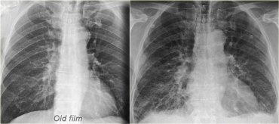
Cardiothoracic Ratio
Increase in heart size compared to the prior (there is also redistribution of pulmonary vascular flow, interstitial edema, and some pleural effusion. To measure the ratio, use the ratio tool (it has a picture of a long and a short measuring stick)

Slide 47
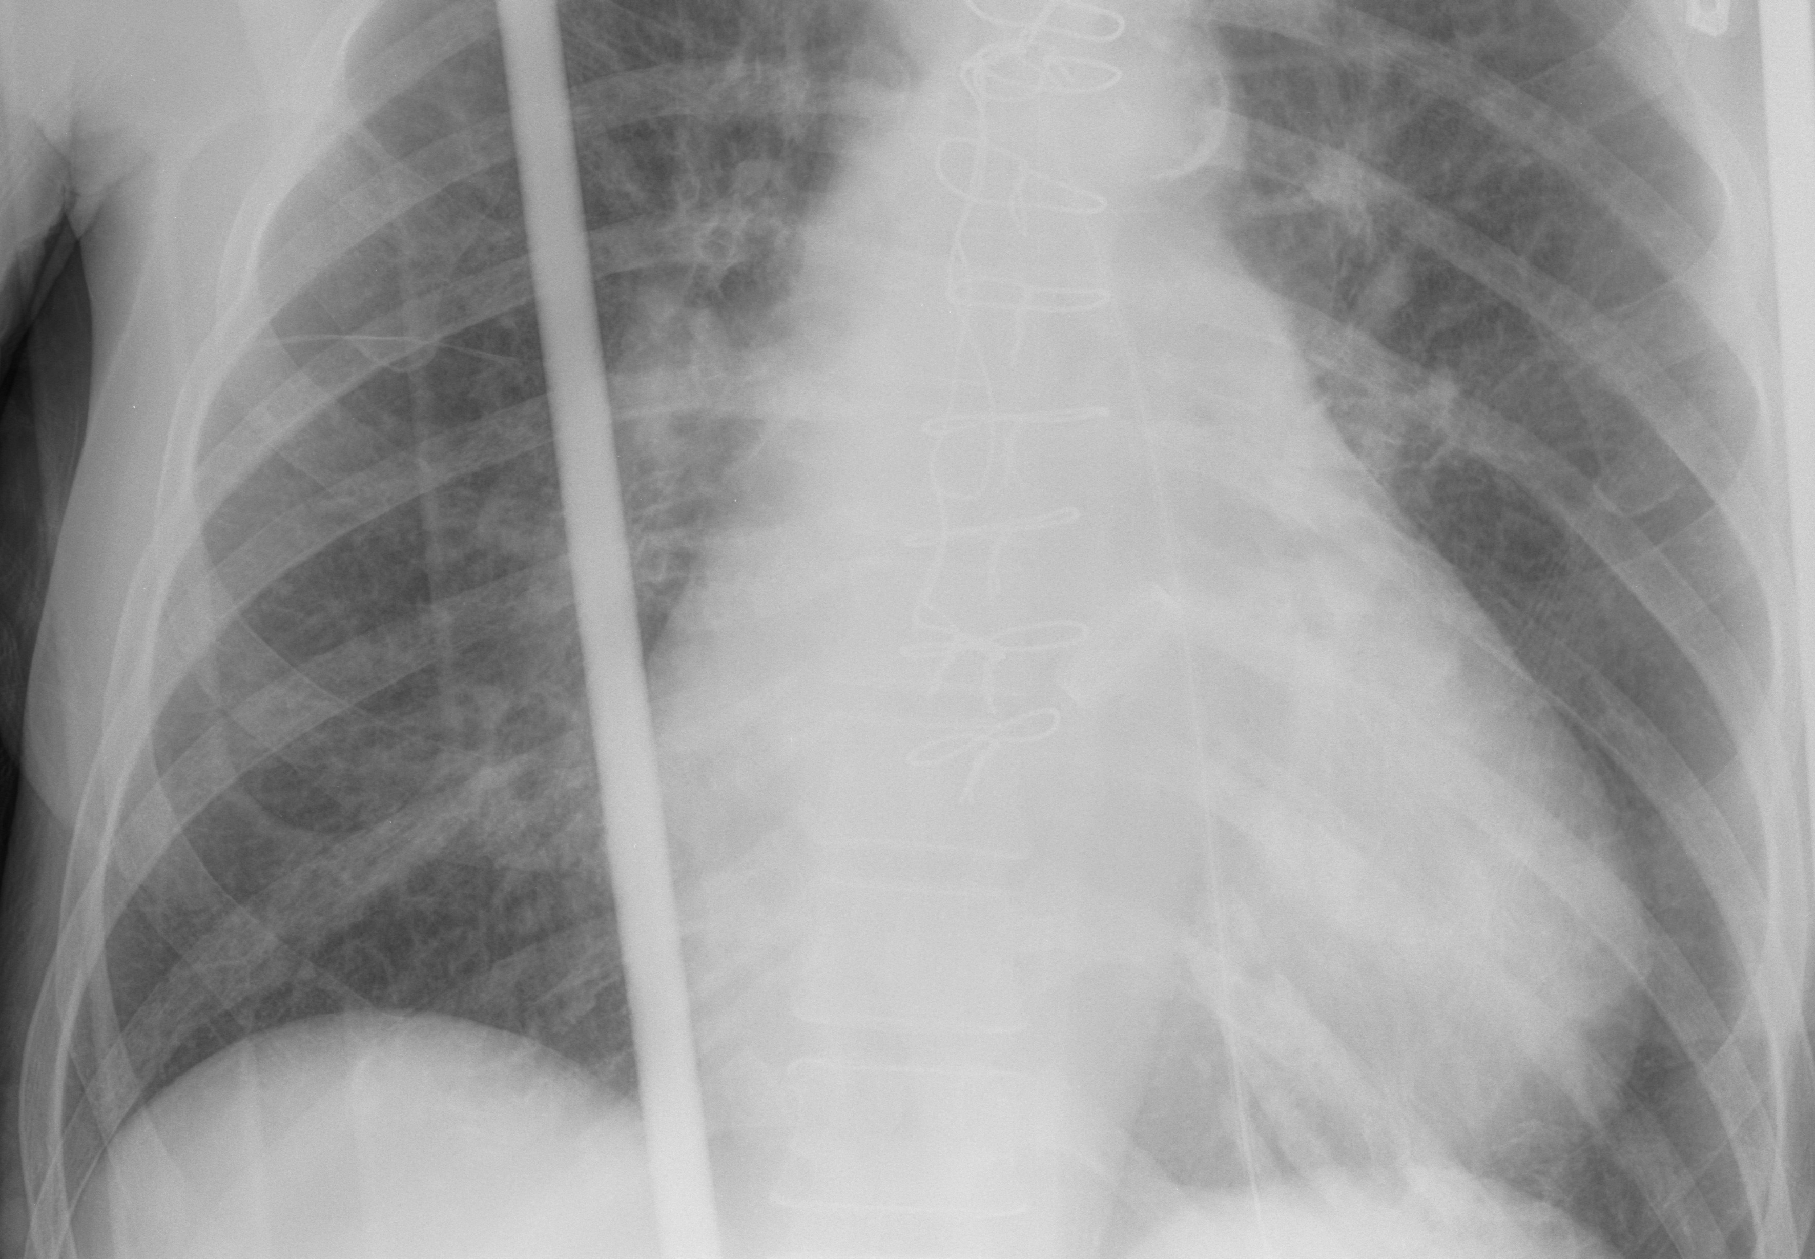
Stage II: Interstitial Pulmonary Edema
Peribronchial cuffing
(interstitial thickening)
Thickened minor fissure
(subpleural thickening)
Indistinct vessels
(often described as “perihilar hazy opacities”)
Large heart
(CHF)
Kerley B lines
(interlobular septal thickening)
CAVEAT: this is a supine/trauma film and
Cephalization will always be seen in supine.

Slide 48
Stage II: Interstitial Pulmonary Edema
Gravity causes the fluid to sit in the dependent portion of the lungs. On both CT and CXR, you’ll see a difference in HU of 100-150 between the dependent and non-dependent part of the lung.
Thickened/edematous interlobular septal lines
Subtle ground glass opacity in the
dependent portions of the lungs

Slide 49
Kerley’s Lines (Cecil’s chapt 84)
They all represent interstitial thickening, but presented in different locations.
Kerley’s A lines – radiate 2-4cm from the hilum toward the pulmonary periphery and toward the upper lobes (thickening of the axial IS)
Kerley’s B lines - ~1cm in length and 1mm in thickness, found in the periphery of the lower lobes, abutting the pleura; reflects thickening of the subpleural IS
Kerley’s C lines – reticular pattern from thickening of the parenchymal interstitia; rarely seen.

Slide 50
Stage III: Alveolar Edema
The indistinct/hazy vessels from stage II edema will gradually turn into patchy consolidations with air-bronchograms as it progresses to stage III.
In acute alveolar damage or ARDS, the transition is much faster (increased capillary permeability)
Severe II
Mild III
Stage III

Slide 51
HRCT protocol
Supine: 1–1.5 mm collimation at 2 cm intervals in full inspiration.
Full inspiration
Window: Mediastinum 440 width, level 40 and Lung 1000 width, level –700
Prone ImagIng: Performed with 1–1.5 mm collimation at 2 cm intervals in full inspiration as noted above.
Expiratory VIews: 1–1.5 mm collimation at end expiration following a forced vital capacity maneuver. Routinely performed at the level of the:
aortic arch,
at the tracheal carina, and
above the diaphragm.

Slide 52
HRCT
Reading algorithm:
Dominant pattern
reticular, nodular, high density, low density
Distribution in secondary lobule
centrilobular, perilymphatic, random
Distribution within lung
Upper zones, lower zones, central or peripheral

Slide 53
Patterns of parenchymal opacity (B&H 347)
Airspace (alveolar filling)
Interstitial opaciites (riticular/linear and reticulonodular)
Branching
Nodular (miliary <2mm; micronodule 2-7mm; nodule 7-30mm, mass >30mm)
Atelectasis

Slide 54
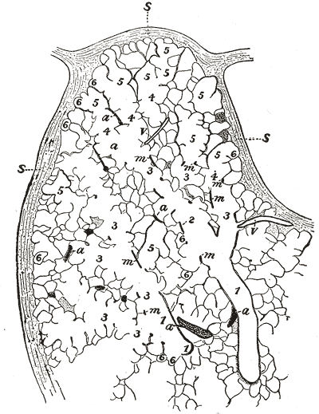
Distribution Within the Secondary Lobule
Centrilobular area
perilymphatic area
1 – bronchiole
2 – respiratory bronchiole
3 – alveolar duct
4 – atria
5 – alveolar sac
6 – alveolus or air cell
M – smooth muscle
A – branch pulmonary artery
V – branch pulmonary vein
S - septum between lobules

Slide 55
Reticular
Septal thickening
Nodular/Irregular – occurs in lymphangitic spread of carcinoma, lymphoma, fibrosis (honeycombing), sarcoidosis, and silicosis
Smooth – usually seen in interstitial pulmonary edema (Kerley B lines on CXR); but can also be seen in lymphangitic spread of carcinoma or lymphoma and alveolar proteinosis

Slide 56
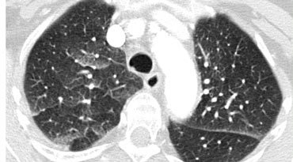
Reticular
Septal thickening and ground glass opacities with a gravitational distribution in a patient with cardiogenic pulmonary edema

Slide 57
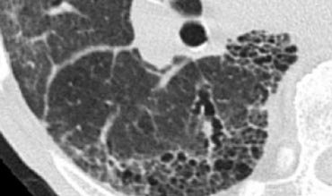
Reticular
Honeycombing/fibrosis

Slide 58
Nodular Pattern
The distribution of nodules on HRCT is important to narrow the ddx:
Random: involves the pleural surfaces and fissures; hematogenous spread
Centrilobular: 5-10mm away from the pleura
Perilymphatic: on the pleura, interlobular septa, and the peribronchovascular interstitium (mostly subpleural)

Slide 59
Nodules
Multiple Nodules
Pleural nodules
Perilymphatic
Random
No pleural nodules
Centrilobular
Sarcoid
Silicosis
Lymphang ca
Miliary infect (Tb, fungal)
Metastases
Hypersens, PNA, Resp Bronchiolitis, BAC, infxn

Slide 60
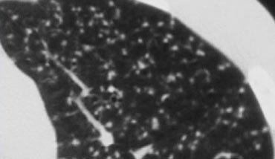
Nodular - Random
Miliary Tb from hematogenous spread

Slide 61
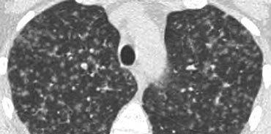
Nodular - Random
Langerhans cell histiocytosis (smokers)

Slide 62
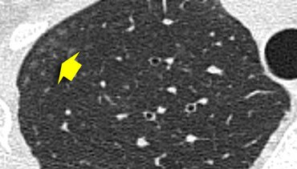
Nodular - Centrilobular
Hypersensitivity pneumonitis (below)
Respiratory bronchiolitis (smokers)
Infectious airways disease (endobronchial spread of mycobacteria)

Slide 63
Nodular - Centrilobular
Tree-in-bud represents dilated and impacted (mucus or pus) centrilobular bronchioles
Almost always infection [endobronchial spread of Tb(below)/MAC/bacterial pna]

Slide 64
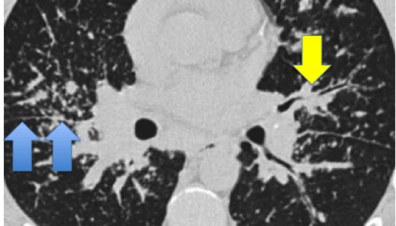
Nodular - Perilymphatic
Most commonly seen in sarcoidosis(below), also in silicosis, coal-worker’s pneumoconiosis, lymphangitic spread of carcinoma
Blue Arrows– bronchovascular bundles
Yellow - perilymphatic

Slide 65
High Attenuation Pattern
Ground Glass
(partial filling)
Consolidation
(complete filling)

Slide 66
Ground Glass
Probably the most common opacity-type you’ll see, because it’s so nonspecific
Acute
Pulmonary edema (CHF/ARDS)
Partial atelectasis
Pulmonary hemorrhage
Pneumonia (viral/mycoplasma/PCP)
Acute Eosinophilic PNA
Chronic
Hypersensitivity pneumonitis
Organizing pneumonia (BOOP/COP)
Chronic Eosinophilic PNA
Alveolar proteinosis (crazy paving)
Lung fibrosis (UIP/NSIP)
Bronchoalveolar carcinoma

Slide 67
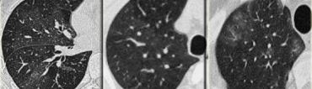
Mosaic Attenuation
Infiltrative process adjacent to normal lung (hemorrhage/pus/tumor)
Normal lung appearing relatively dense adjacent to air-trapping (asthma/obstructive bronchiolitis)
Hyperperfused lung adjacent to oligemia (chronic thromboembolic disease)
Constrictive OB Chronic PE Pulmonary Hemorrhage

Slide 68
Consolidation
Airspace disease
Pneumonia – PCP, viral, Mycoplasma, bacterial, Eosinophilic PNA, Organizing PNA (BOOP, COP)
Edema – CHF, ARDS, AIP
Fibrosis – UIP, NSIP, radiation, prior infection, senile (really old)
Tumor – Bronchoalveolar carcinoma, lymphoma
Idiopathic – Sarcoid, Alveolar proteinosis

Slide 69
Consolidation
Organizing PNA (unresolved PNA) – patchy non-segmental consolidations in a subpleural/peripheral distribution
If unknown dx, its called cryptogenic OP (COP)

Slide 70
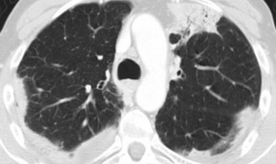
Consolidation
Chronic Eosinophilic PNA – idiopathic condition characterized by extensive filling of alveoli by eosinophils; responds to steroids

Slide 71
Low Attenuation Pattern
Air-filled lesions [emphysema, cysts (LAM, LIP, Langerhans cell histiocytosis), bronchiectasis, honeycombing

Slide 72
Cystic Lung Disease
Pneumatoceles (seen in intubated pts, PCP)
Honeycombing
Langerhans cell histiocytosis (less common)
Lymphangioleiomyomatosis (LAM)

Slide 73
Honeycombing
UIP or Interstitial fibrosis
IPF
RA scleroderma
Drug reaction
Asbestosis
End stage hypersensitivity pneumonitis
End stage sarcoidosis

Slide 74
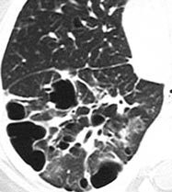
Cystic Lung Disease
Langerhans cell histiocytosis (LCH) – granulomatous disease, which, in the later stages replace with fibrosis and form cysts

Slide 75
Descriptions
Most radiologists have a specific way they like to describe things. Try to learn the terms used by the attending your working with and use them.
For example, some will describe many things on CXR as “ground glass”, whereas others will use the term “hazy” and save ground glass for CTs only.

Slide 76
Descriptions
Diffuse lung disease – differentiation between alveolar and interstitial lung disease isn’t recommended (poor correlation to histology)
Opacity – lg>1cm (in largest dimension); sm<1cm
Large opacities
Diffuse homogenous– diffuse alveolar damage, increased permeability pulmonary edema, diffuse viral pna, or PJP
Multifocal patchy– multifocal bronchopna, recurrent aspiration, vasculitis
Lobar (w/o atelectasis) – lobar pna
Lobar (w/ atelectasis) – obstruction of a lobar bronchus
Perihilar– hydrostatic pulmonary edema, renal failure, volume overload, pulmonary hemorrhage

Slide 77
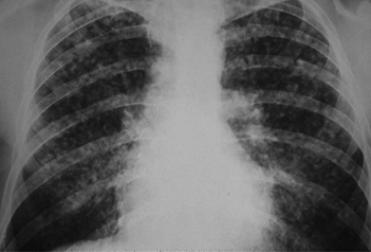
Descriptions
Small opacities
Micronodular (nodules <1mm) – talc granulomatosis, alveolar microlithiasis, rare cases of silicosis, talcosis, coal worker’ pneumoconiosis, beryllium-induced lung diseases, occasionally in sarcoidosis or hemosiderosis.
Nodular (up to 1cm) – infections, inflammatory granulomas (miliary tb), sarcoidosis, fungal dz, extrinsic allergic alveolitis, and langerhans cell histiocytosis

Slide 78
Descriptions
Reticular patterns – small polygonal, irregular, or curvilinear opacities. DDx varies according to the timeline of the change.
Acute – IS edema, atypical pneumonitides (viral or mycoplasmal pna), early exudative changes, in a connective tissue disorder (SLE), and acute allergic reactions (transfusion reactions or reactions to Hymenoptera stings).
Chronic – idiopathic IS pna, connective tissue diseases (particularly scleroderma and rheumatoid lung), asbestosis, radiation pneumonitis, end-stage hypersensitivity pneumonitis, drug reactions, lymphangitic spread of cancer, end-stage granulomatous infection, lymphoma in its bronchovascular form, Kaposi’s sarcoma in its bronchovascular manifestation, and sarcoidosis.

Slide 79
Descriptions
Honeycombing - Restructuring of pulmonary anatomy accompanied by bronchiectasis.
Multilayer of small subpleural spaces between 3-10mm in diameter. They can be distinguished from paraseptal emphysema by their thicker wall and multiple layers
Alveolar – characterized by acinar nodules, 0.6-1cm in diameter. These nodules encompass an acinus and surrounding peribronchial tissue.
patterns include gg opacities (incomplete alveolar filling), coalescent large opacities, consolidation involving whole lobes or segments, opacification in a bronchocentric distribution, air bronchograms, and air alveolograms.
Bronchial patterns are seen as linear, tubular, or cystic lucencies and opacities that follow expected path of bronchi. Mucoid impaction (asthma, abpa, plastic bronchitis) leads to opacities described as toothpaste, cluster of grapes, or finger-in-glove.
Dirty lung – seen in smokers c chronic bronchitis results in bronchial wall thickening, peribronchial fibrosis, respiratory bronchiolitis, and pulmonary arterial htn

Slide 80
Chest Pathology
Upper zone
Tb
Fungal dz
Sarcoidosis
Pneumoconioses
Langerhans cell histiocytosis
CF
End-stage hypersensitivity pneumonitis
Ankylosing spondylitis
Radiation pneumonitis
Basilar
Bronchiectases
Aspiration
Drug reactions
IS pulm fibrosis, nonspecific IS pneumonitis, desquamative IS pneumonitis, cryptogenic organizating pna, bronchiolitis obliterans c organizing pna
Asbestosis
scleroderma

Slide 81
Chest Pathology
Lymph nodes; following conditions a/w hilar and mediastinal LN enlargement
Sarcoidosis
Lymphoma
Fungal dz
Tb
Metastatic ca
Silicosis, coal worker’s pneumoconiosis, beryllium lung
Pulmonary nodules – majority c multiple nodules have metastatic dz.
Predilection for subpleural lung regions, including the interlobar fissures
Can be seen in HIV/Kaposi’s sarcoma, and lymphoma
Infection (mult abscesses from recurrent aspiration or septic emboli; tb and ntm granulomas; fungal processes, including histo, coccidiomycosis, and cryptococcosis; and infection c flukes, such as paragonimus westermani)
Noninfectious inflammatory – includes wegener’s granulomatosis, rheumatoid nodules

Slide 82
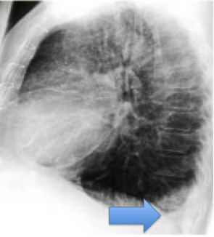
Pleural Effusion
75mL obscures post CPS, 150mL obscures the lat CPS, 200mL produces a rind of 1cm in thickness on decubitus films, 500mL obscures the diaphragm and is also visible on supine films, and 1000mL reaches the level of the 4th ant rib on upright CXRs. An effusion of >200mL can be sampled by thoracentesis. The smallest amount visible of decubitus films is 10mL. With care, as little as 175mL of effusion can be detected on supine films (free layering effusions produce a veil of opacity or filter effect).

Slide 83
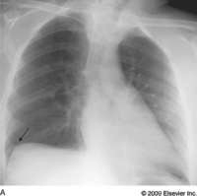
Subpulmonic Effusion
They mimic an elevated hemidiaphragm. The highest curvature point of the pseudodiaphragm is shifted laterally. Large effusions can lead to diaphragmatic inversion. Separation of the lung base from the gas-containing stomach indicative of a subpulmonic effusion, particularly when the gas bubble is displaced inferomedially.

Slide 84
Pleural Disease
Pleural plaques – hyalinized collagen fibers
Calcs are visible on CXR in 20% and CT scans in 50% of individuals c plaques
Plaques preferentially involve the parietal pleura adjacent to ribs 6-9 and the diaphragm
They are less pronounced in the intercostal spaces and spare the costophrenic sulci as well as the apices.
Over the diaphragm, they appear as curvilinear calcifications or scalloping
Viewed en face, they can simulate lung disease.
Likened to holly leaves, sunburst patterns, geographic patterns, or stippled or irregular structures
Rare visceral pleural plaques occur in interlobular fissures can mimic pulmonary nodules

Slide 85
Pleural Disease
Diffuse pleural thickening – in response to exposure to any stimuli including infection, inflammation, trauma, tumor, thromboembolism, radiation, and asbestos
Severe – results in formation of a generalized pleural peel c smooth margins and usually less than 2cm in thickness. Radiologically diffuse pleural thickening is characterized by smooth, noninterrupted pleural opacity involving at least a quarter of the chest wall circumference, obliterating the CPS and encompassing the apices. CT criteria >3mm
PTX
on upright CXRs, gas is usually found in the apicolateral pleural space and no vascular structures are visible beyond the pleural line. The most sensitive is lateral decubitus.
Expiratory CXRs are not necessary for dx
Supine - pleural gas accumulates in a subpulmonic location; and outlines the CPS, forming the dep sulcus size.

Slide 86
Lung transplantation
Remember that post-lung transplantation CTs need to be protocoled a certain way (including a expiratory scan to look for air-trapping – often the first sign of rejection).
Cryptogenic organizing pna – bronchiectasis, cysts, fibrsosis
Post-transplant lymphoproliferative d/o – seen after 1 yr; lymphoid neoplasms primarily of B-cell; EBV found in 90%, seronegative EBV status prior to tranplant; early occurrence in post-op
Recurrence of primary dz
Sarcoidosis most commonly recurrent prim dz (35%)
Lymphangioleiomyomatosis
Langerhand cell histiocytosis

Slide 87
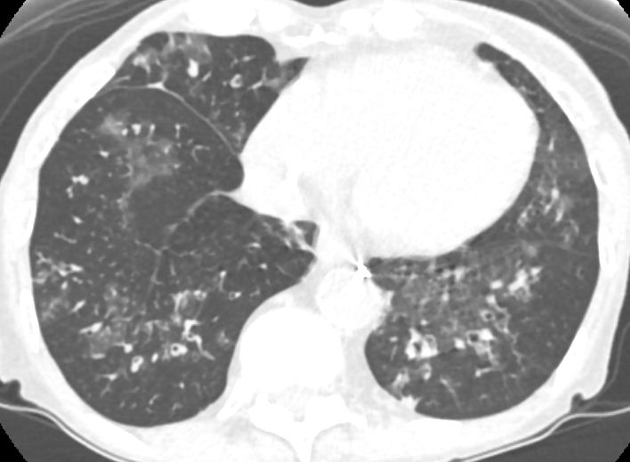
Lung transplantation
Example of chronic rejection in a post-transplant patient

